Slide 1


IS THIS ARTICLE FACT OR FICTION?
April Meyer
Using machine learning to identify when an article might be fake

Slide 2
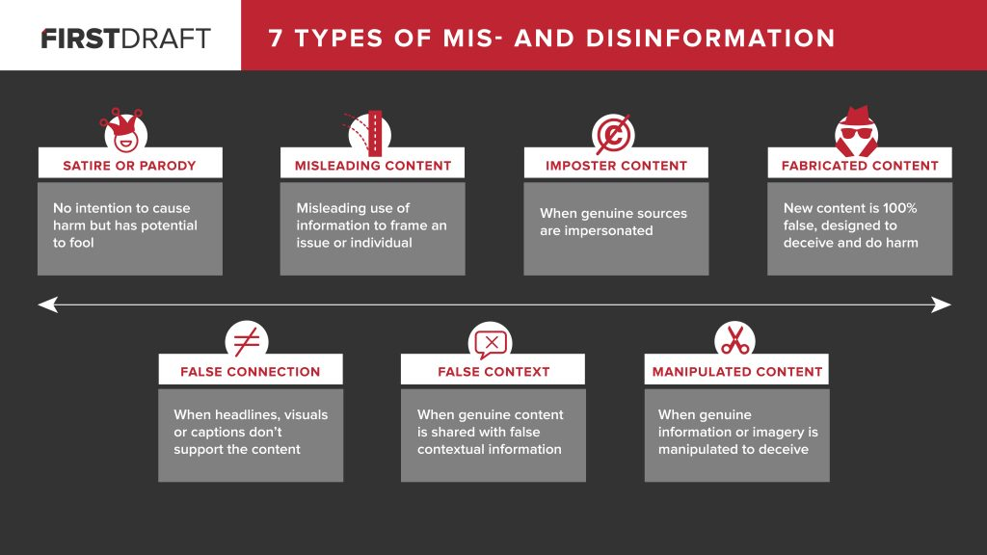
About Us
What is “False News”?
Information is at our fingertips with the advancements of technology, but with that substantial amount of data and information comes false information.
It is a story that is manufactured with no verifiable data, sources, or references (1). It may be intended to mislead the reader or to receive economic incentives for having higher readers. Social media has only made it easier and faster to spread fake news.
Above is a visual created by Claire Wardle to show the types of misinformation (1).

Slide 3



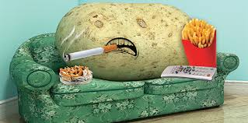

The Problem with Fake News
Violence
Trust
Decreased Grades or Reputation
Harmful to Your Health
Fear
False stories that target groups can have serious consequences such as bullying and violence against innocents.
Decreased trust in public institutions
Using sources that have false or misleading information, will get a lower grade.
Trusting false stories related to medical treatments and major diseases could lead you to make decisions that may be harmful to your health.
Possibly stop doing or going out from fear based on a fake story.

Slide 4




Solution – Learning Algorithm
Input Data
Model Updates
Analyze
The input data occurs in consecutive order and the model is updated step-by-step.
If the predication is correct the model does not change (passive) and if the predication is incorrect the model will update (aggressive).
Accuracy scores and confusion matrix will be used to evaluate the model
Use a Passive Aggressive Classifier to help identify fake articles. It is a ‘online-learning algorithm ‘.

Slide 5
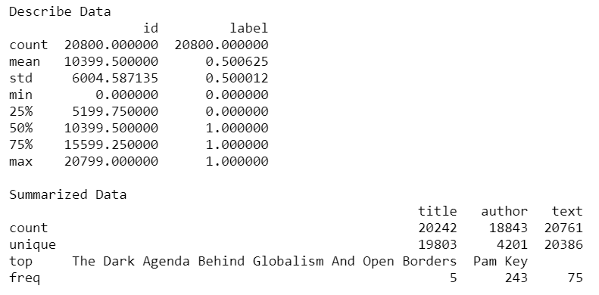
Data Source and Information
The data is from Kaggle - https://www.kaggle.com/c/fake-news/data.
Data Attributes -
id: unique id for a news article
title: the title of a news article
text: the text of the article (might be incomplete)
label: a label that marks the article as potentially unreliable
1: unreliable
0: reliable

Slide 6
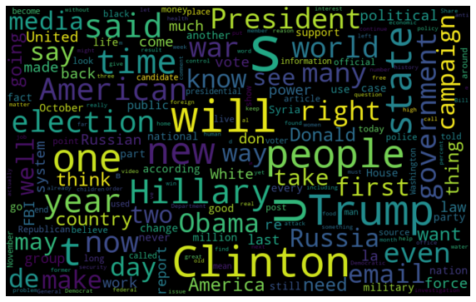
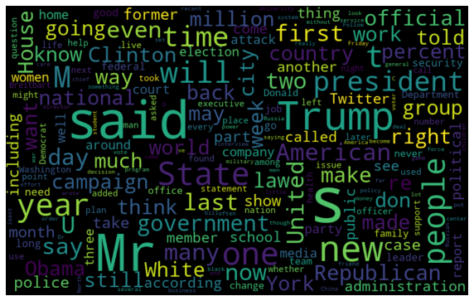
Common Words
Fake News – WordCloud
Real News – WordCloud

Slide 7


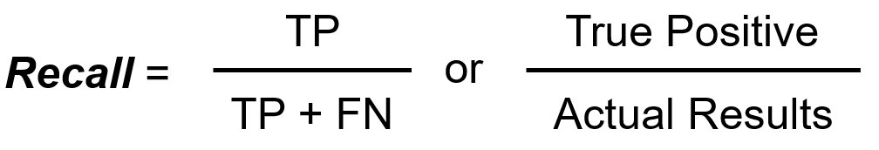
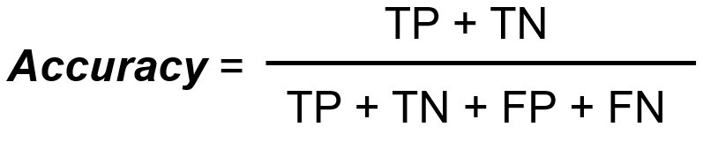
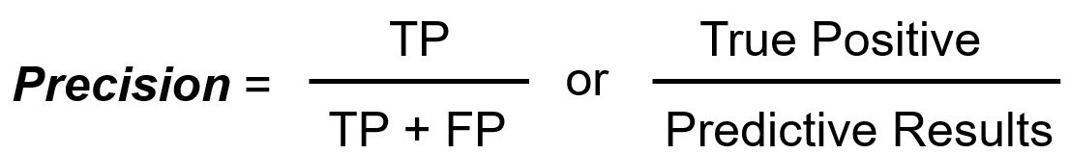
Metrics Used to Evaluate Model
Accuracy Scores
Confusion Matrix
TP = True Positive
TN = True Negative
FP = False Positive
FN = False Negative
Created to show if there is an imbalance in classes causing the accuracy score to be high.
Using the confusion matrix, precision and recall can be calculated.

Slide 8
Confusion Matrix Results
2033
67
True Positives
False Negatives
81
1979
False Positives
True Negatives

Slide 9
Accuracy, Recall, Precision Scores
Accuracy
Precision
96.44%
96.17%
96.81%
Recall
shows how many are actual positive out of the predicted positive.
show how many of the Actual Positives the model captured by labeling it as True Positive.

Slide 10

Summary
Overall, the PassiveAggressiveClassifier performed well in predicting if an article was fake or real. It had an accuracy of 96.44% with a precision 96.17% and recall of 96.81.
Future applications of this model could be used by social media website/apps to filter out the fake news or miss-information that shows up on customer’s feeds. I would also like to investigate seeing if using the ‘title’ feature to predict the article’s likelihood of being Fake.

Slide 11



Thank You
April Meyer
apmeyer@my365.bellevue.edu

